Slide 1








Slide 2
Project Title: Web Scraping and EDA on Real Estate Website:- Makaan.com
Problem Statement :
Comparison of real estate in Delhi to determine which places are best for buying property in Delhi

Slide 3
Web Scraping
Web scraping refers to the extraction of web data on to a format that is more useful for the user.
Web scraping can help you extract any kind of data that you want. You would then be able to retrieve, analyze and use the data the way you want. So web scraping simplifies the process of extracting data, speeds it up by automating it and creates easy access to the scrapped data by providing it in a CSV format.

Slide 4
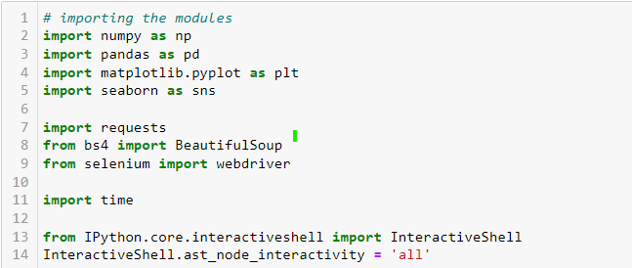
Data Extraction
Importing all necessary modules for extracting data and data analsis

Slide 5
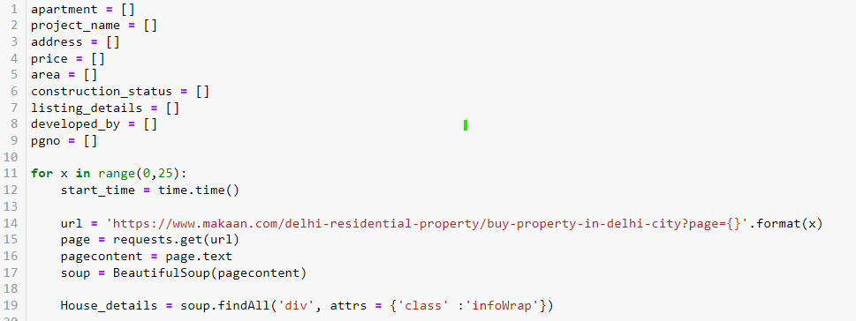
Data Extraction
Here we are gathering the information of each page and dividing the classes and storing the information into list.

Slide 6
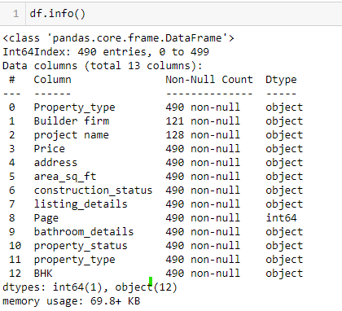
Data Extraction
I have extracted and imported around 13 column and saved as .csv file.

Slide 7
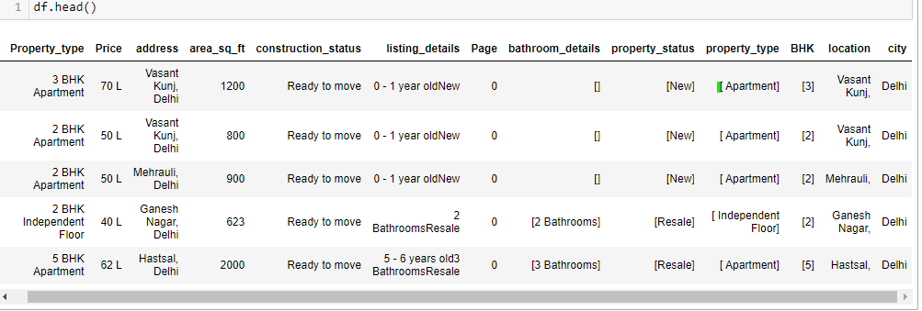
Data Cleaning
Here I have deleted two columns Builder firms and project name because only 120 real estate property have these details.
Here we can see bathroom details is also not present is some properties so we have dropped these rows.

Slide 8
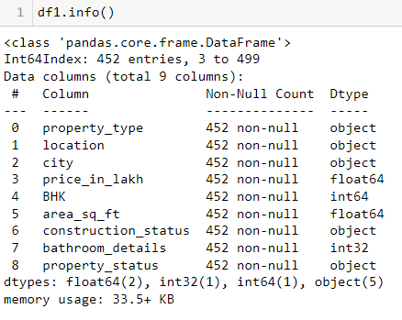
Data Cleaning
This is our final data set It has 9 columns and 452 rows.

Slide 9
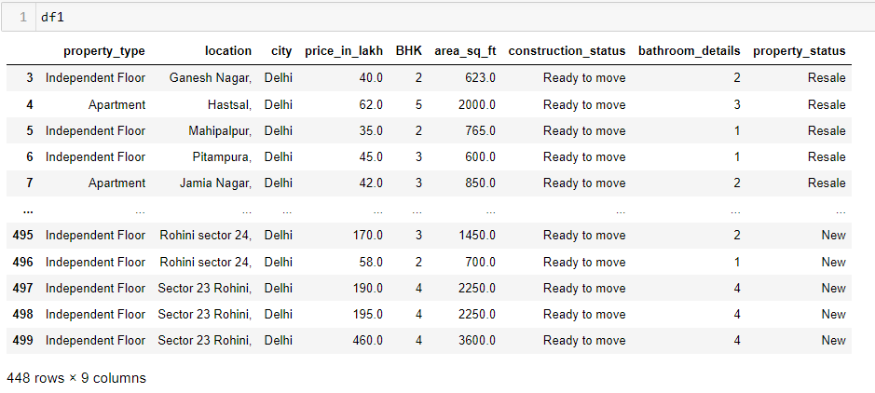

Slide 10
Data Visualization
Univariate Analysis:
It is used to summarize only one variable at a time.
Bivariate Analysis:
Bivariate statistics compare two variables and determine relation between them.
Multivariate Analysis:
Multivariate statistics compare more than two variables.

Slide 11
Univariate Analysis

Slide 12
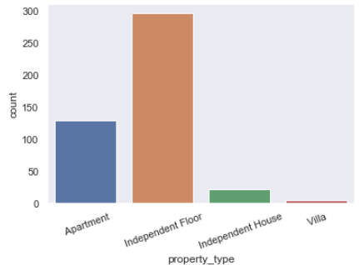
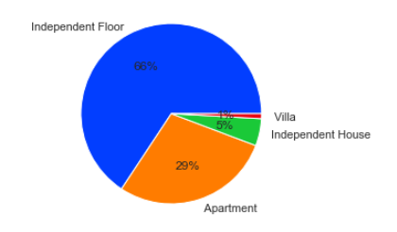
Property Type
In the given data of 452 rows:
66% properties are Independent Floor
29% properties are Apartment
5% properties are Independent House
1% properties are Villa.

Slide 13
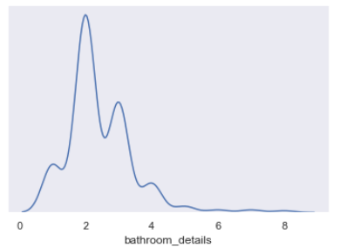
Bathrooms
Most of the house have 2 bathrooms and 3 bathrooms
a very few house have 1 and 4 bathrooms

Slide 14
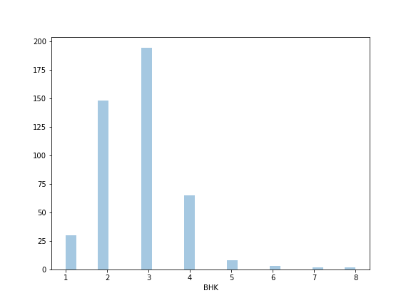
BHK
There is total 452 properties most of which are 2 BHK or 3 BHK.
followed by 4 BHK and then 1 BHK and so on.
and there are very few properties which have more than 4 BHK.

Slide 15
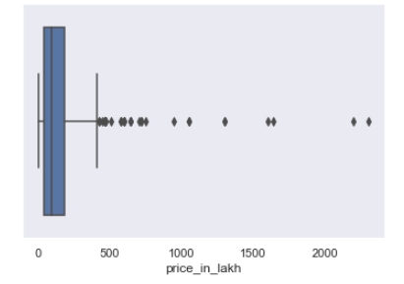
Price
In the given dataset price of the properties lies from 25 lakh to 2 crore and there are so many outliers in data set.

Slide 16
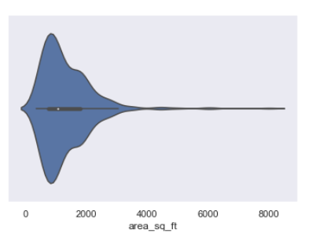
Area of the property
In the given data area of properties lies between 200 sq ft to 4000 sq ft.

Slide 17
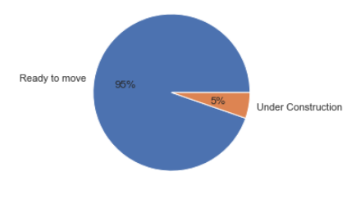
Construction Status
95% of house are ready as majority of house are on resale.
whereas only 5% properties are under construction.

Slide 18
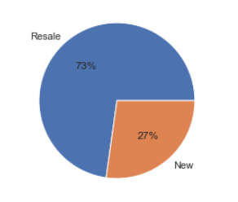
Property status
In the given dataset majority of properties are old as they are on resale whereas 27% properties are new.

Slide 19
BIVARIATE ANALYSIS

Slide 20
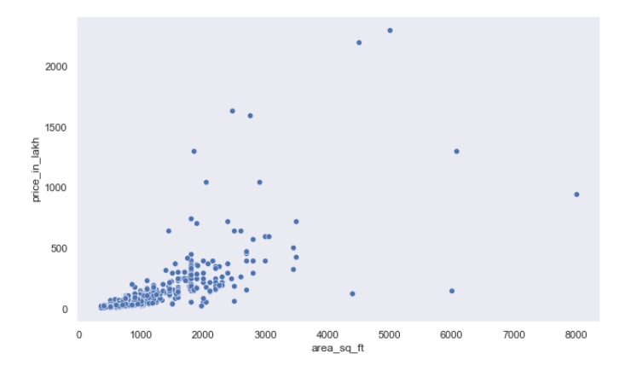
Interpretation:- Here we cannot able to observe proper relation between size of the property and price of the property as the there are so many factors which affect the price too like location and other facilities. But there is still a positive relation between area and price.

Slide 21
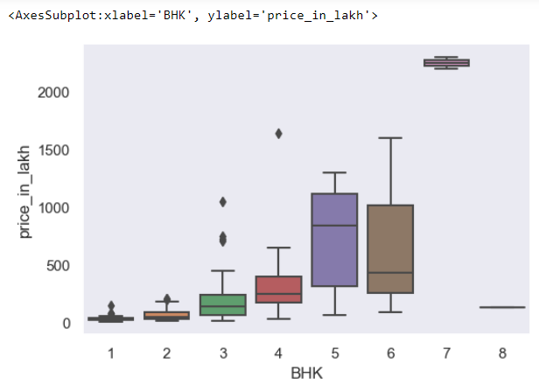
Interpretation:- There is positive relation between BHK and price as the number of BHK is increasing so the price is also increasing whereas we can also see an exception at 6 and 8 BHK where price is lesser.
There are some outliers which of because if the places.

Slide 22
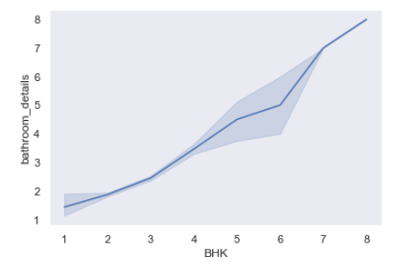
Interpretation:- There is positive relation Between BHK and number of Bathrooms.
But we can also see slight dips in the mid.

Slide 23
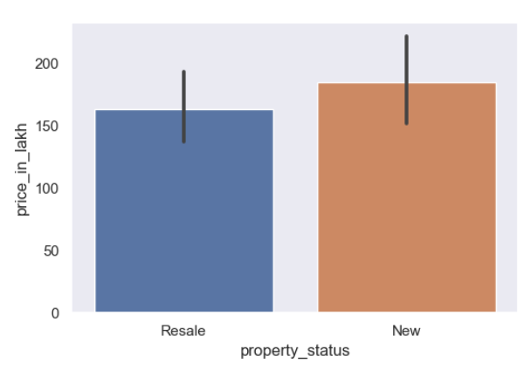
Interpretation :- prices of new properties are higher than those properties which are on resale.

Slide 24
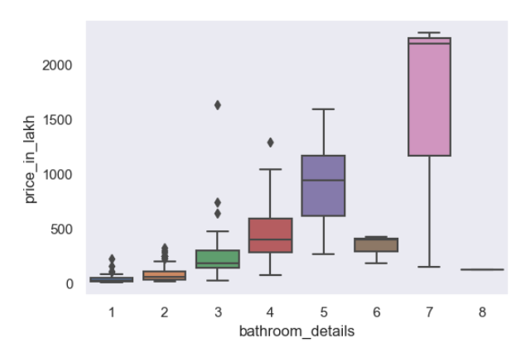
Interpretation:- There is positive relation between price and number of bathroom. whereas there are some exception are also present in data set.

Slide 25
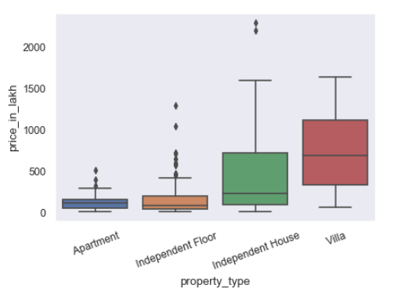
Interpretation :-
Villa is the costliest property.
Independent house prices lies from 1 crore to 8 crore.
There is not much difference between the prices of Apartment and Independent Floors.
But there are too many outliers in Independent floors.
There are very few Villa. in the dataset.

Slide 26
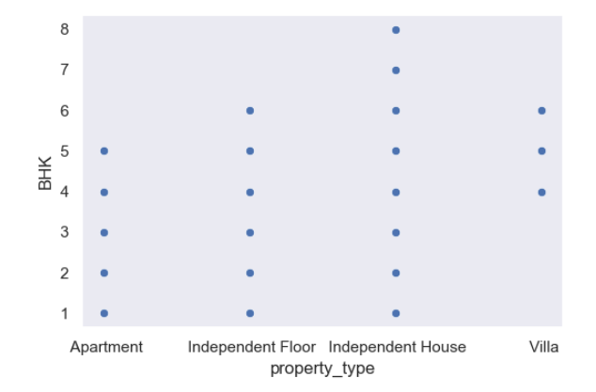
Interpretation :-
Apartments size lies from 1 BHK to 5 BHK.
Independent floor size lies from 1 BHK to 6 BHK.
Independent house lies from 1 BHK to 8 BHK.
Villa size lies from 4 BHK to 6 BHK.

Slide 27
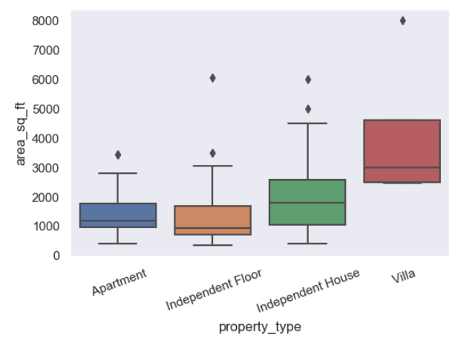
Interpretation:-
Apartments area lies between 200 sq ft to 3000 sq ft with median 1200 sq ft.
Independent floor area lies between 200 sq ft to 1800 sq ft with median 1000 sq ft.
Independent House area lies between 800 sq ft to 6000 sq ft with median 2000 sq ft.
Villa area lies between 2500 sq ft to 3200 sq ft with median 3000 sq ft.

Slide 28
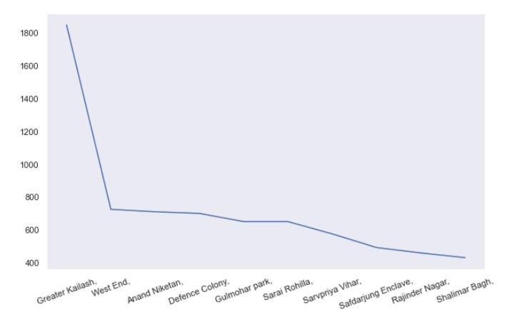
Interpretation :- According to given data set Greater Kailash, West End, Anand Niketan, Defence Colony, Gulmohar Park, Sarai Rohilla, Sarvpriya Vihar, Safdarjung Enclave, Rajinder Nagar and Shalimar Bagh are the Costliest area in Delhi for buying Property.

Slide 29
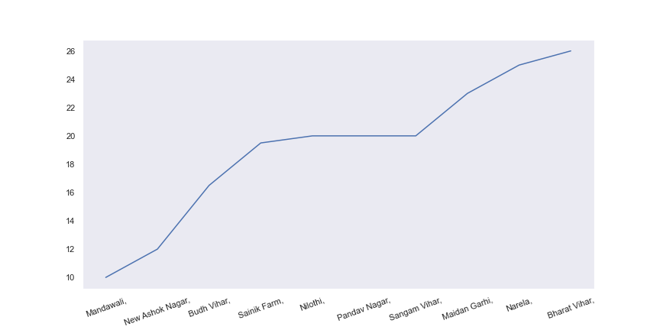
Interpretation :- According to given data set Mandawali, New Ashok Nagar, Budh Vihar, Sainik Farm, Niothi, Pandav Nagar, Sangam vihar, Maidan Garhi, Narela and Bharat Vihar are the cheapest places in Delhi for buying Property.

Slide 30
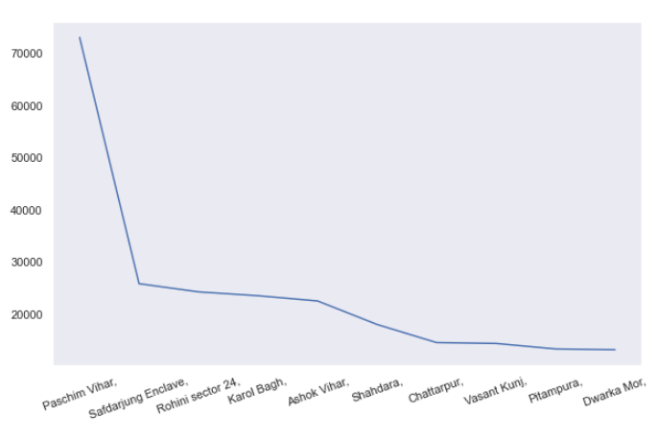
Interpretation:- Paschim Vihar, Safdarjung Enclave, Rohini sector 24, Karol Bagh, Ashok Vihar, Shahdara, Chattarpur, Vasant Kunj, Pitampura and Dwarka Mor are the top 10 places which has alot of space on sale.

Slide 31
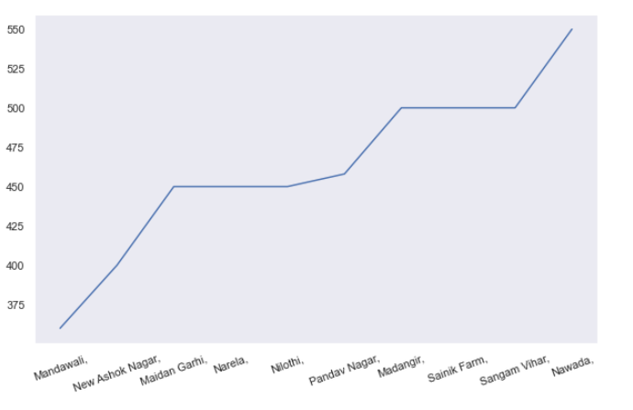
Interpretation:- Vinod Nagar Nath, Maidan Garhi, Narela, Madangir, Sainik Farm, Sangam Vihar, Nawada, Sector 20 Rohini, Khirki Extension, Rohini sector 5 are the top 10 places which has least of space on sale.

Slide 32
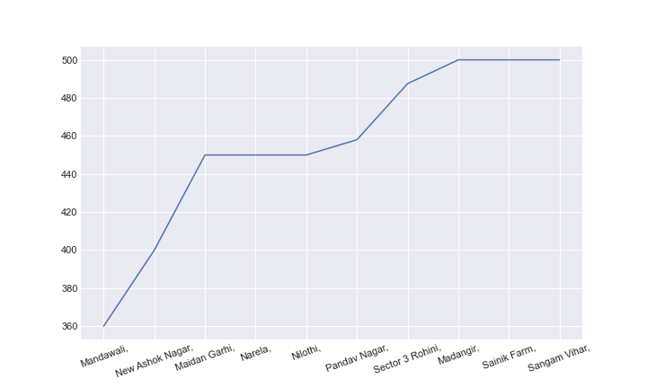
Interpretation:- Mandawali, New Ashok Nagar, Maidan Garhi, Narela, Nilothi, Pandav Nagar, Sector 3 Rohini, Madangir, Sainik Farm and Sangam Vihar
Top 10 smallest properties in terms of area belongs to these places.

Slide 33
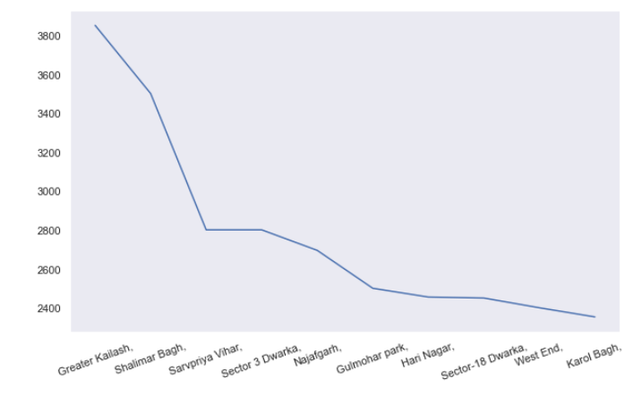
Interpretation:- Greater Kailash, Shalimar Bagh, Defence colony, Sarvpriya Vihar, Sector-18 Dwarka, Najafgarh, Gokalpur, Gulmohar park, Karol Bagh, Hari Nagar top 10 biggest properties in terms of area belongs to these places.

Slide 34
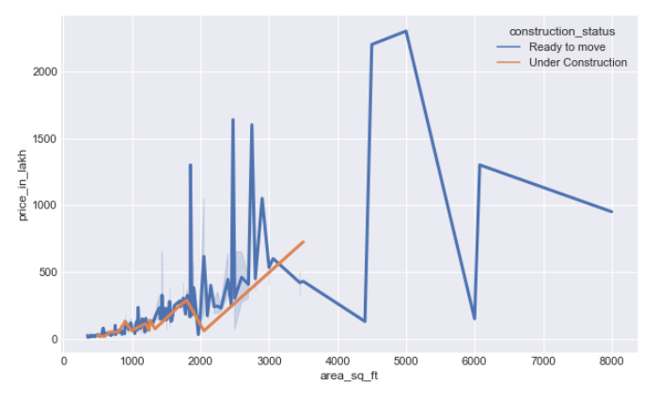
Interpretation:- we have already observed that there is positive relation between area and price but even with same area properties which are ready to move there prices are higher than the properties which are under construction.

Slide 35
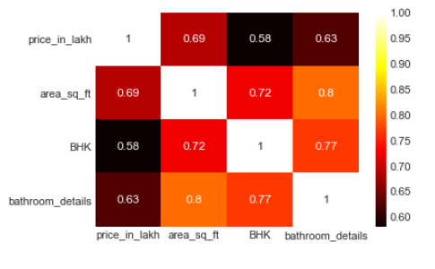
Interpretation:- All the variables are positively correlated to each other.

Slide 36
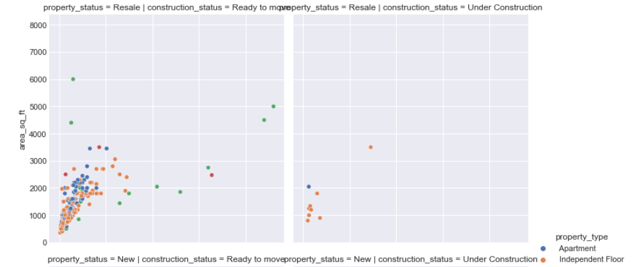
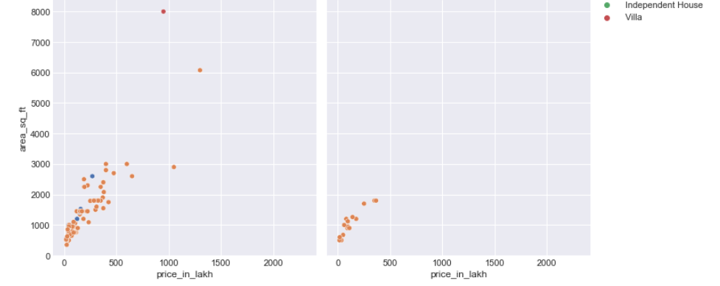
Interpretation:- Most apartments are on resale and ready to move. there are very few which belongs to other three category.
Independent floor is present in all four categories.
There is no new independent home all are on resale and ready to move.

Slide 37
Summary
In the given data set average price of the properties are 1.77 crore. minimum price is 12 lakh whereas maximum is 23 crore so we can properlt see that data is distributed.
Maximum BHK in houses is 8 and minimum is 1 and average is 3 BHK.
Maximum square feet is 6075 where as the minimum is 350. we can see that the data is distributed.
Bathroom details are quiet similar too BHK.
According to the dataset Greater Kailash is the most expensive place to buy property in Delhi.
Vinod Nagar North is the cheapest place to buy property in Delhi.
Independent floors are the highest in all property types.
Bathrooms in the properties are highly correlated with the size of property.

Slide 38

THANK YOU

